Slide 1
Est-ce que tu vas réussir a devenir le personnage que tu as choisi?
Est-ce que tes adversaires vont prouver tu connaitre mieux que tu te connais toi-même?
Et toi? Vas-tu mieux réussir a déterminer la personnalité ludique – le personnage que veulent jouer tes amis?

Slide 2
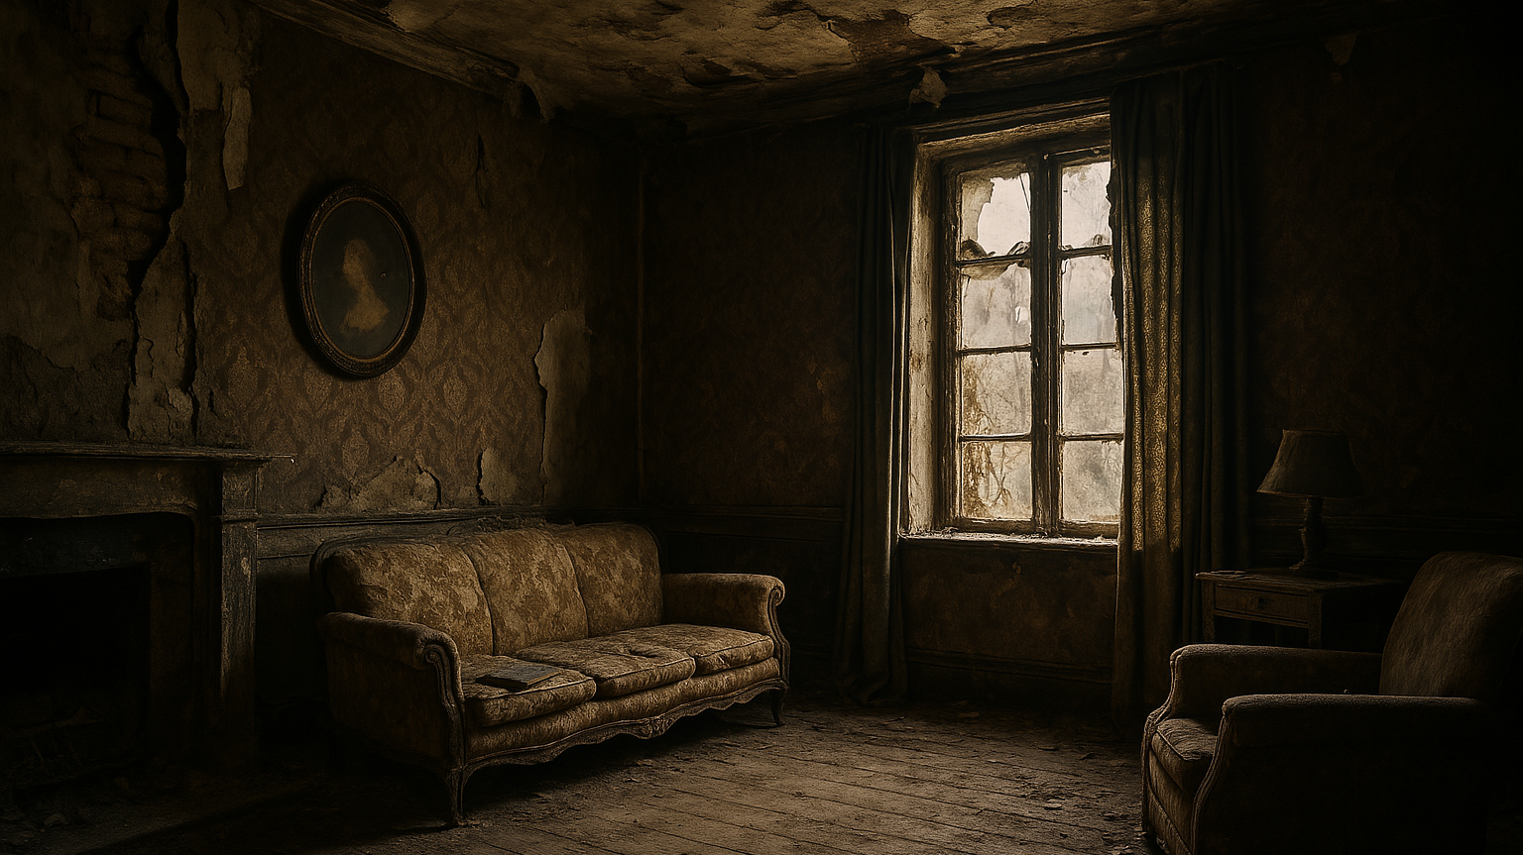
You used to be rich, famous, successful and glorious but those days are long gone. They are lost in the abysses of times.
YOU ARE alone in AN OLD ROOM WITH COMPLETE AMNESIA.
DO YOU:
Check the book on the sofa
Look out through the window

Slide 3
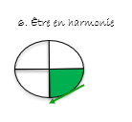
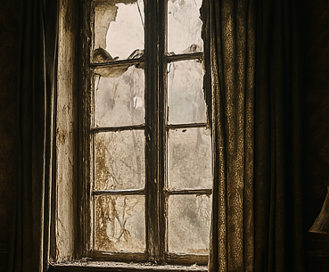

You can’t see anything outside. The window is so old and dusty and it’s completely sealed.
Do you try to:
Break it open
Check the book on the sofa

Slide 4
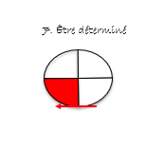
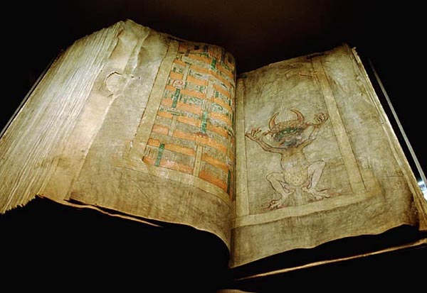
You tried to hit the window. But it’s imopssible to break. You realize the book on the sofa is open on a page.
Do you:
Read the words out loud
Read in silence

Slide 5
You realize the book on the sofa is open on a page.
Do you:
Read the words out loud
Read in silence

Slide 6

You realize the book on the sofa is open on a page.
Do you:
Read the words out loud
Read in silence

Slide 7
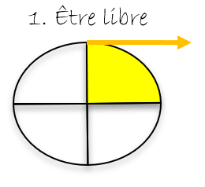
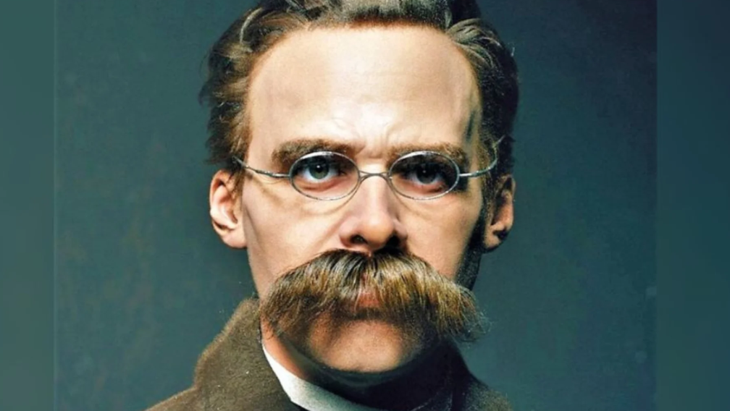
You decided to read the words out loud. You hear a dark voice echoing.
You feel something fishy about these protocols.
Do you:
Contact the police
Decide to try to decipher their meaning on your won
« These are the protocols of the elders… »

Slide 8

You decided to read the words in silence:
“I was forged in the shadows of Tsarist Russia by spies of a midnight meeting, a blueprint for world domination, a gospel for the throne of conspiracy.”
You feel something fishy about these protocols.
Do you:
Contact the police
Decide to try to decipher their meaning on your won

Slide 9
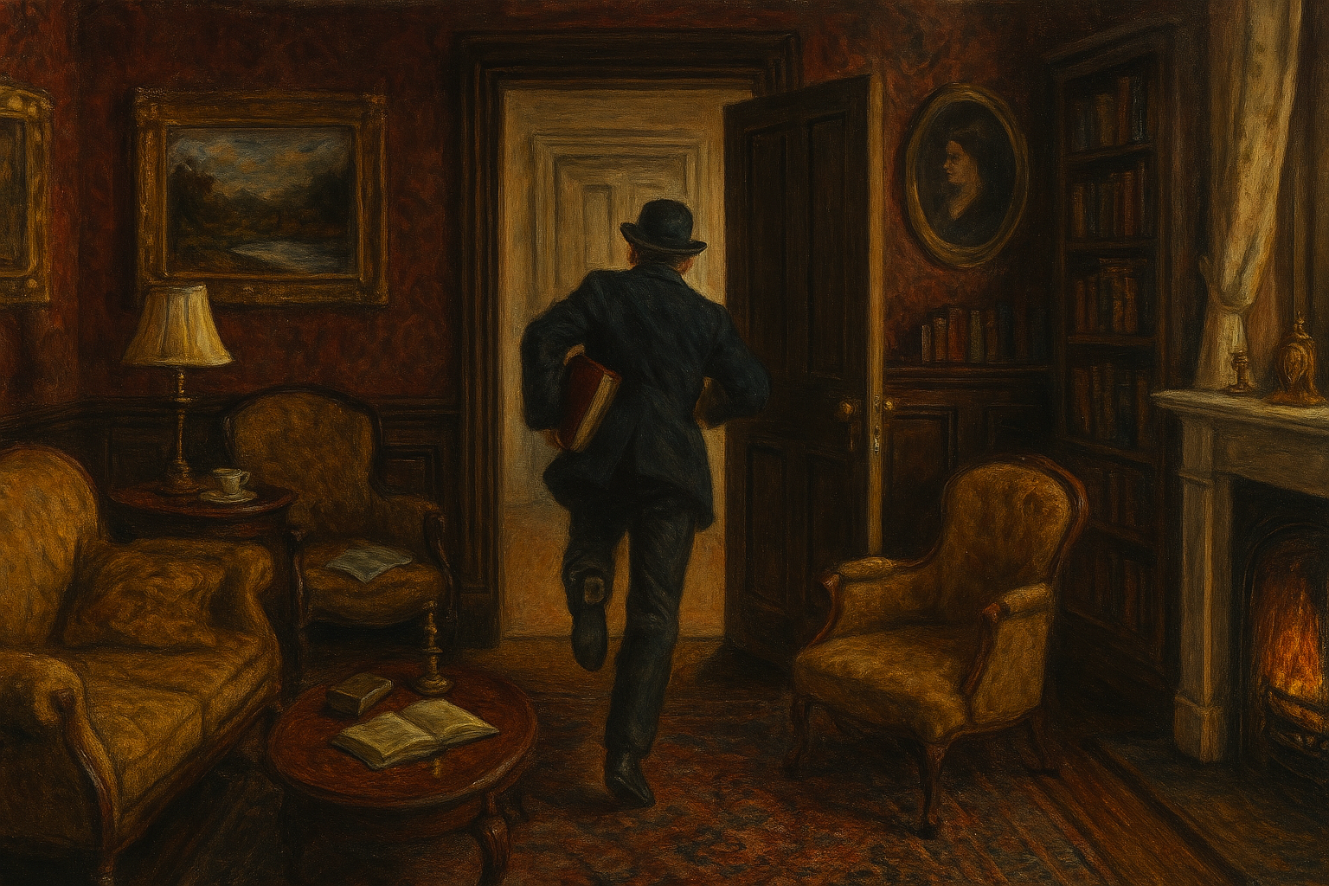
You didn’t have the time to start deciphering that an intruder ran in and stole the manuscript.
Do you: a. run after the man b. call the police

Slide 10
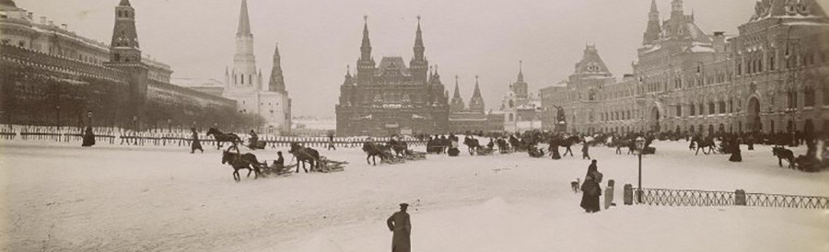
You successfully called the police. They came to fetch you out of that old house. They brought you out. They said that they are called “Okhrana”.
Do you:
Ask them to give you more explanation
Just follow them and do what they tell you to do

Slide 11
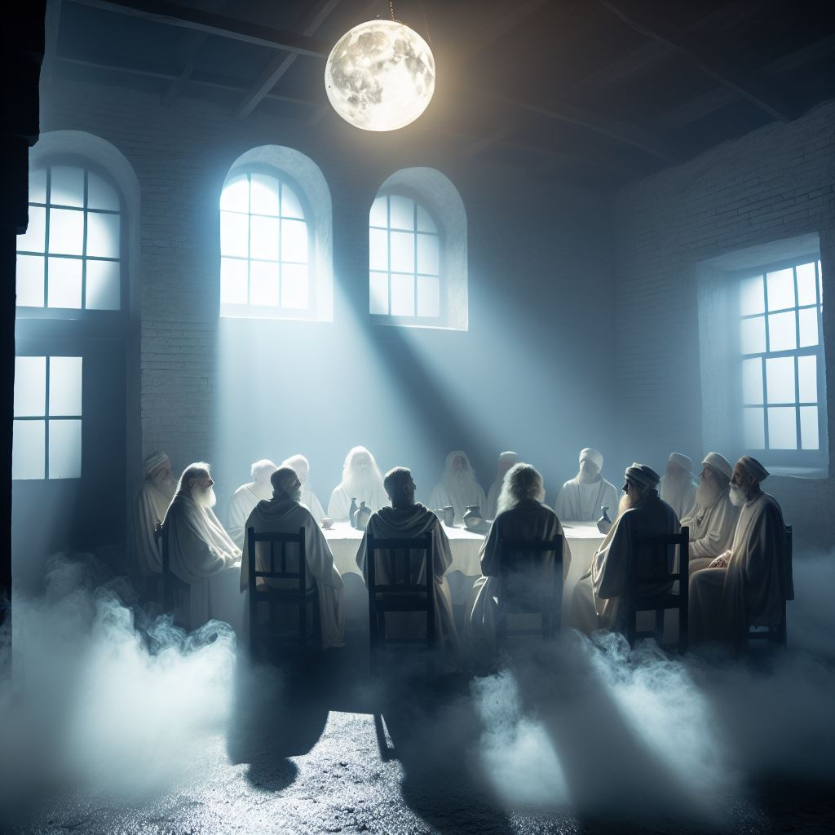
You have followed the man who has entered an underground passage before leading to what looked like a secret meeting room.
Good job!
You have successfully found the seret society’s lear!
End of Chapter 1

Slide 12
You decided not to ask the secret police any question, in order to avoid arousing any suspicion. Thanks to that, the police have showed you a passage leading to a secret meeting room.
Good job!
You have successfully found the seret society’s lear!
End of Chapter 1

Slide 13
Thanks to the police, you have found a passage leading to what a secret meeting room.
End of Chapter 1

