Slide 1
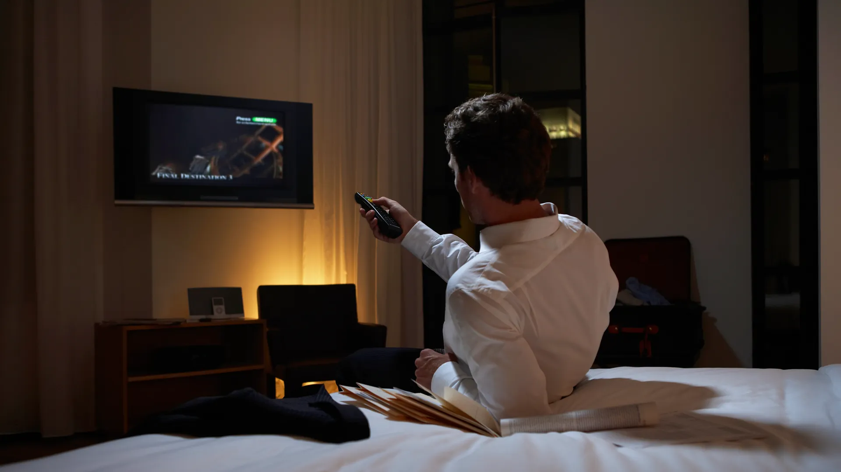
You see yourself lying on a bed, watching some random news on TV.
But you have a strange feeling. What happened? Who are you? Where are you?
Who do you call to inform about this deception you just learned about?
On TV appears a conversation between Ayatollah Romeini and Benjamin Netanyanu !!
They are laughing cynically: “The whole world is believing it!!!!
Ah Ah! And together we will attack Europe! They won’t believe it!”
Putin
Trump

Slide 2
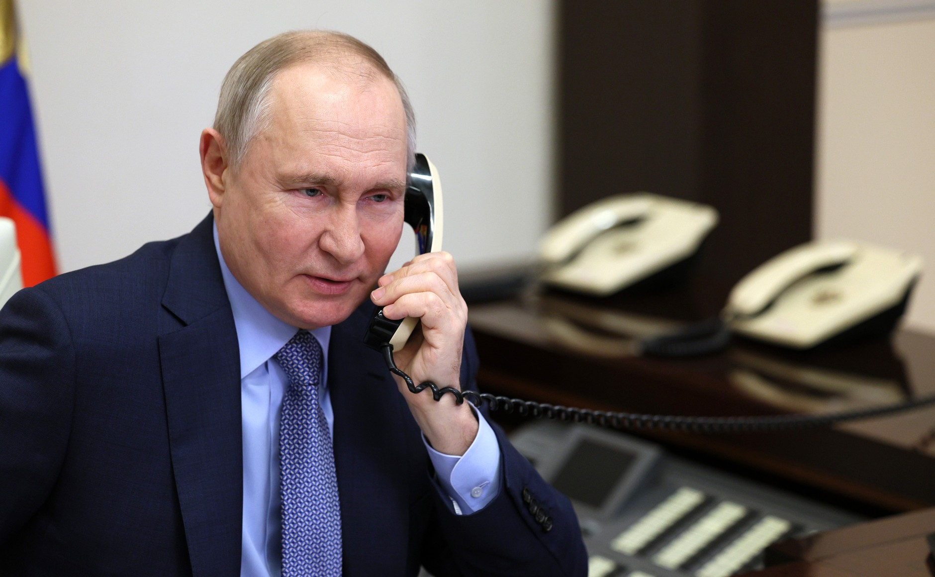
Putin: Who are you?
You: I don’t know but I know the truth. The war between Israel and Iran is a fake. All the images are produced on…
Putin: On purpose! I know did you really think I was not aware?
You:
YES
NO

Slide 3
Putin: Well, now you know !
Putin has just hung up on you!!!

Slide 4

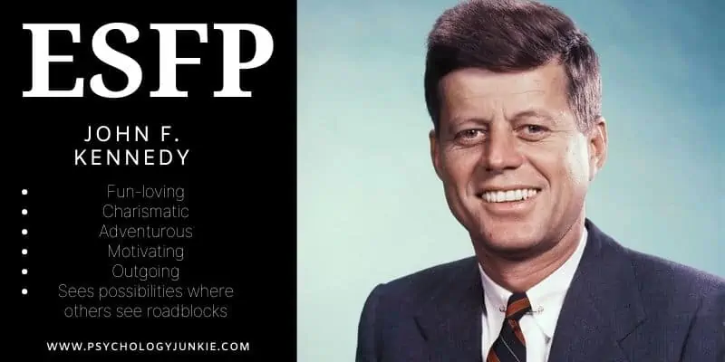
Who do you call?
JFK
Trump
Who do you call to inform about this deception you just learned about?

Slide 5
Before any sort of misunderstanding takes place, I must first inform you that I’m dead, so, bear in mind that I can’t be of much help, however.
I must tell you that you should go to Australia in 2085 to find the secret letter written by the Queen Elizabeth in 1986.
a. « Why? »
b. Ok. I will go now!
Who do you call to inform about this deception you just learned about?

Slide 6
The year 2085 is when the Queen stipulated that letter could be opened!
Ok, I will go using my time machine!!
Who do you call to inform about this deception you just learned about?

Slide 7
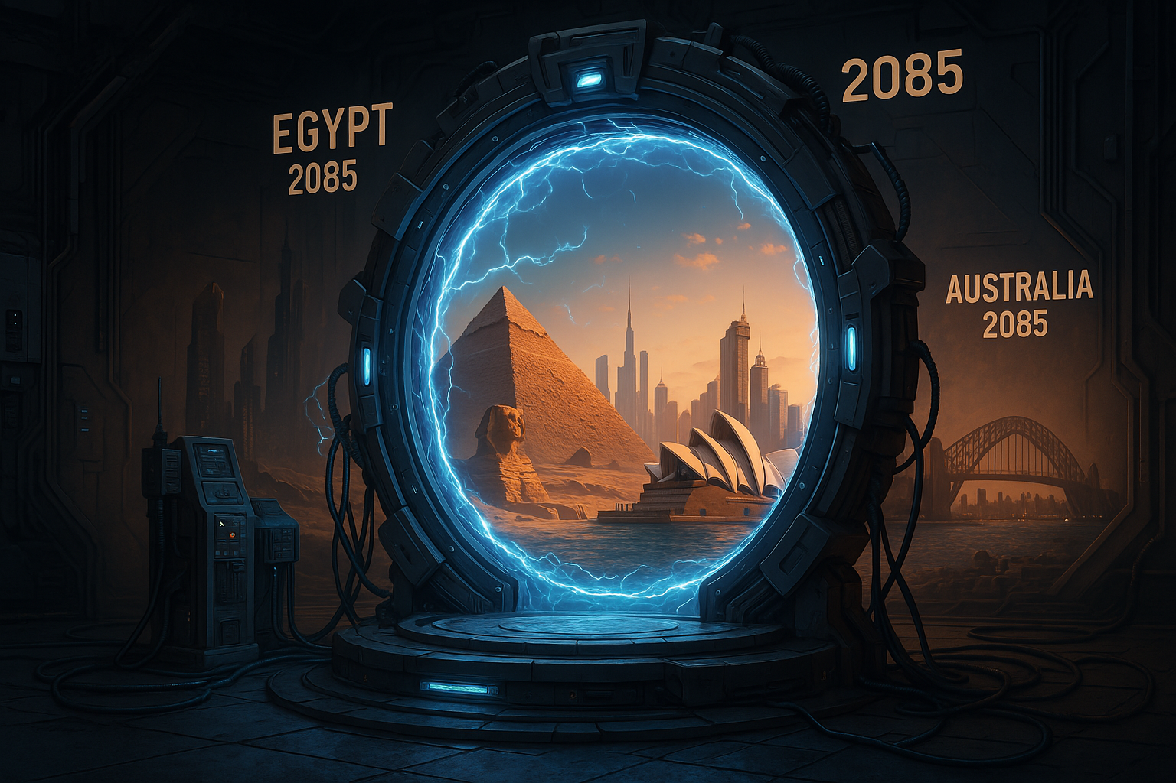
You
are entering the time machine that will bring you to Australia in 2085!!!

Slide 8
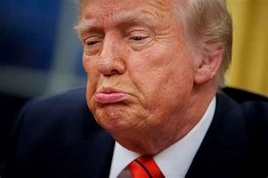
Go to Australia in 2085 to find the secret letter written by the Queen Elizabeth in 1986.
a. « Why? »
b. Ok. I will go now!

Slide 9
The year 2085 is when the Queen stipulated that letter could be opened!
« Ok, I will go using my time machine!! »

Slide 10
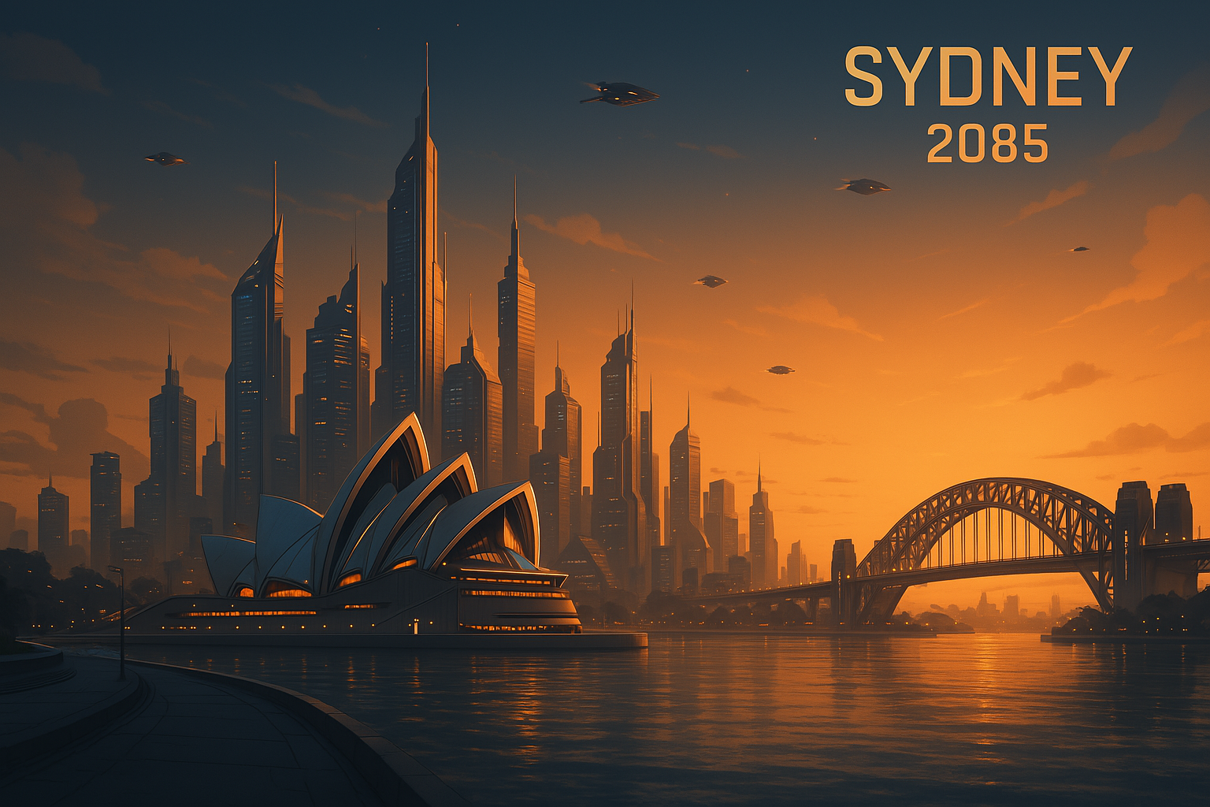
You are now in Australia in 2085 but you need to find the letter before somebody else opens it.
What do you do?
Go to Queen Victoria Building where it is located
Wait for the secretary to bring the letter to the President

Slide 11
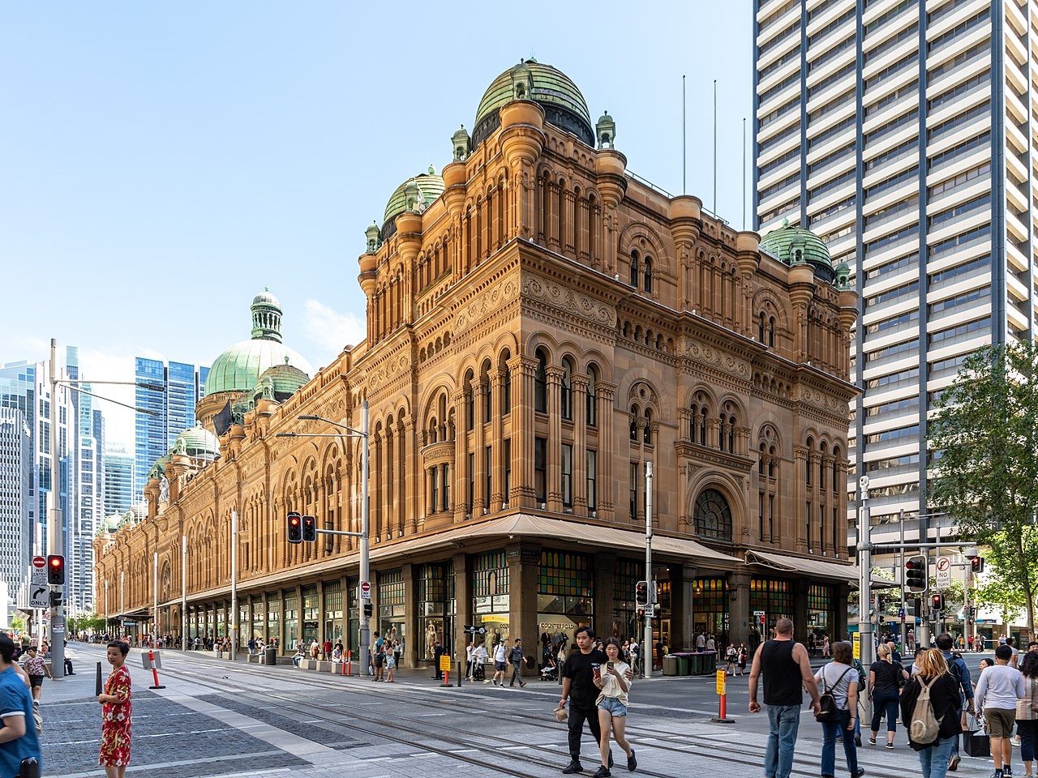
Where do you think the letter is located:
a. Ground floor
b. Top floor

Slide 12
WRONG!!!!!!!!!!!!!
It’s in the dome at the top of the building!

Slide 13
Yes, there it is.
So, do you:
Just walk in to check it out
Throw a bomb at it

Slide 14
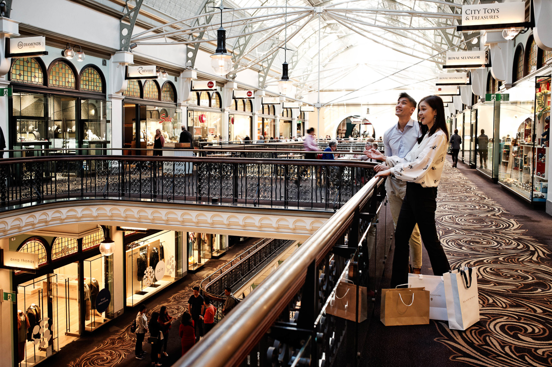
You meet a young couple: “Are you looking for the secret letter?” They ask you smiling:
a. “Yes, I am. Where can I find it?”
b. “No, I don’t know what you are talking about…”

Slide 15
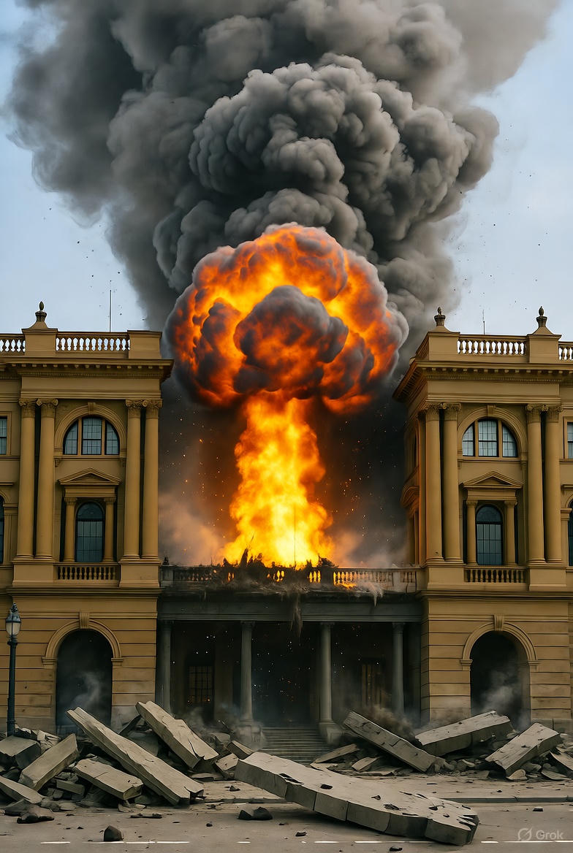
Was that of any help?
You lost….
☹☹☹☹☹

Slide 16
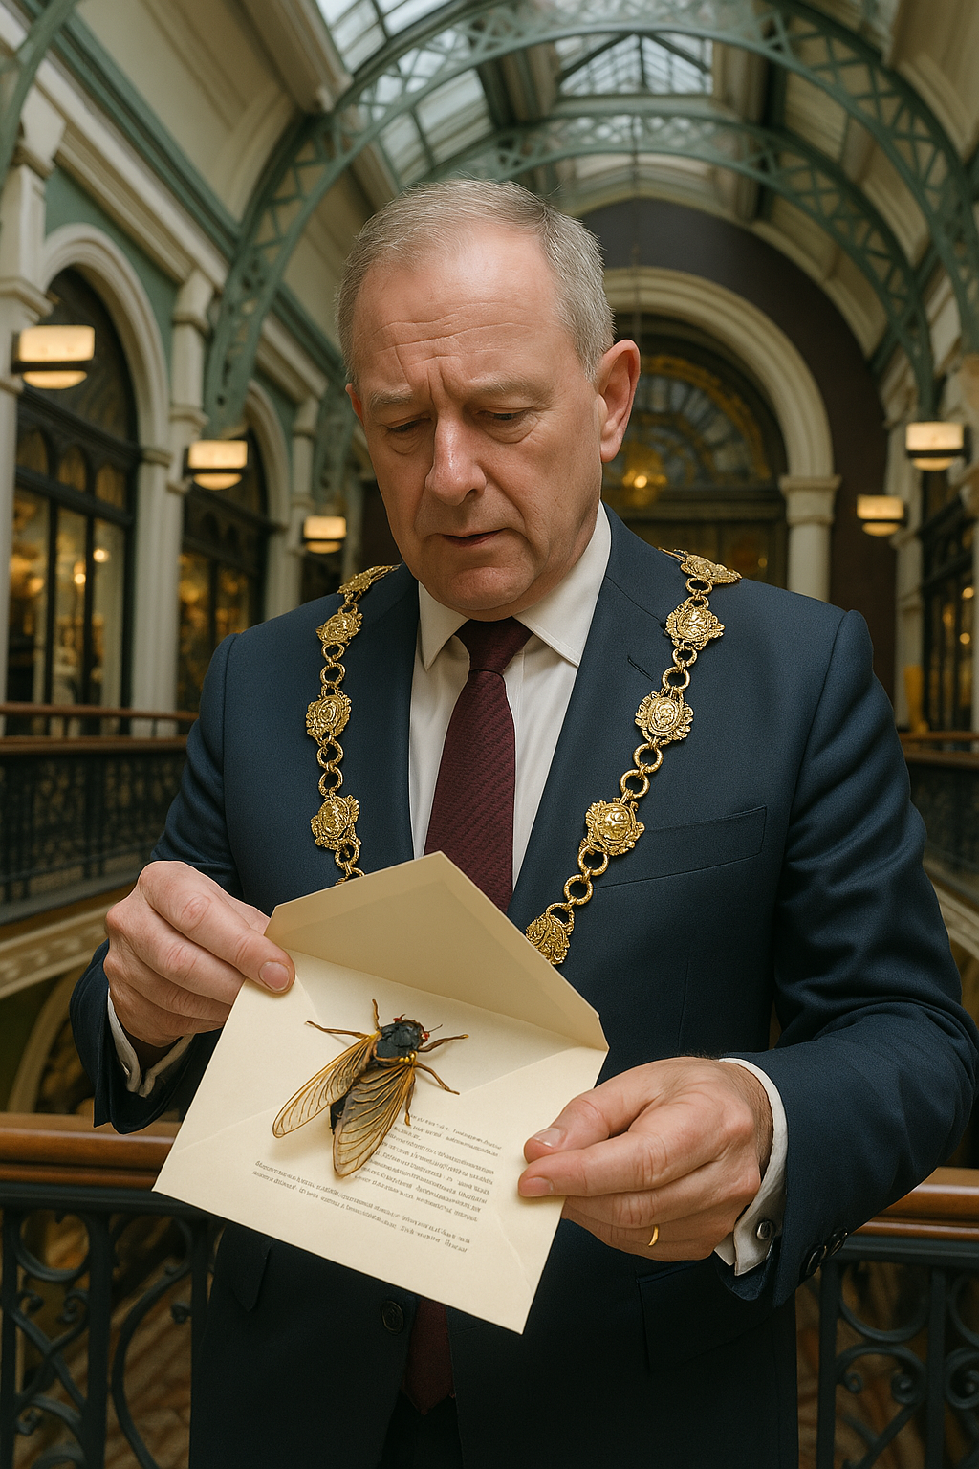
They bring you to a man who opens it.
It it there’s cicada and the message is:
“thank you for having waited so long. Now that the technology allows, find the secret code hidden in the cicada”
Do you try to find the code?
Yes
No

Slide 17
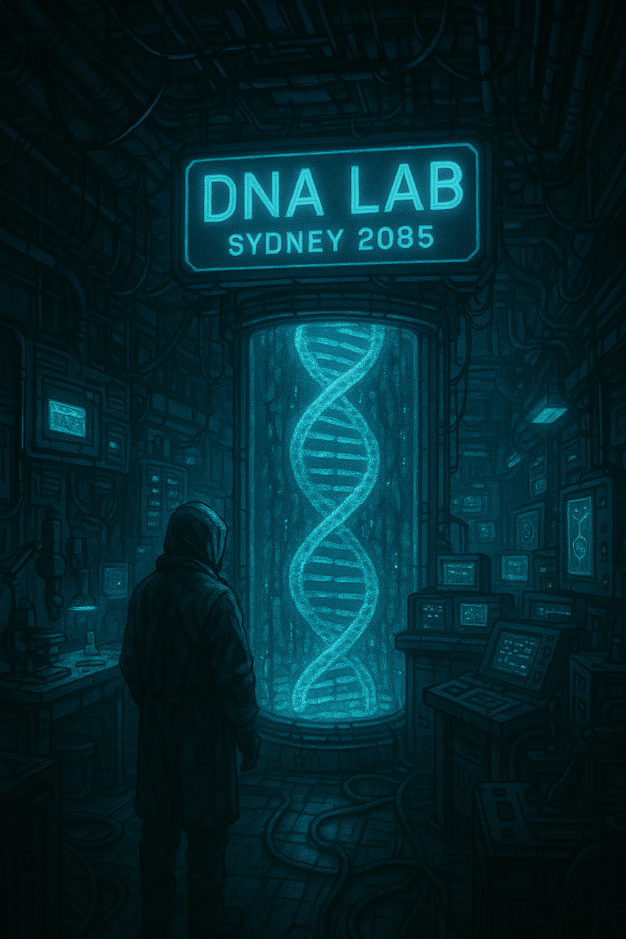
Is that to know who the ancestors are?
Interestingly enough, a piece of Queen Victoria’s DNA strand was hidden in the cicada.
And Alongside the DNA, you read this message: “Mix it with the current leader of Israel.”
The “current” leader, what does that mean, you wonder, the current leader, like now, in 2085, or back in 2025, your original year?

Slide 18
You made the right choice. Now you’re back in front of your TV, but you got some DNA from Queen Victoria that was inserted into the DNA of a cicada, and you need to mix it up with Netanyaduno’s DNA. What do you do?
Go to Israel!
Just watch TV!

Slide 19
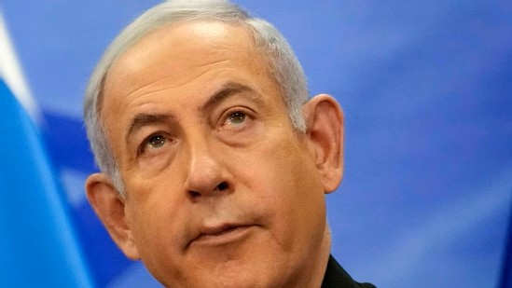
« Thank you for helping me out. As you know, we, and Iran, pretend to hate each other, but it’s only to maintain the World Order in status-quo. Come to my office »
A. Yes, please.
B. No, thank you.

Slide 20
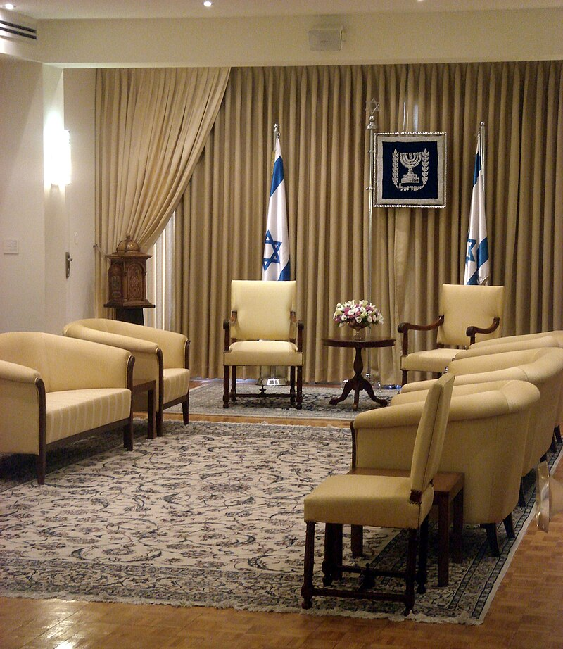
You are invited to discuss with Netanyanu.
Do you reveal that you had the mission to mix his DNA with Queen Victoria’s, and you are asking why such a thing?
A. Yes
B. No

Slide 21
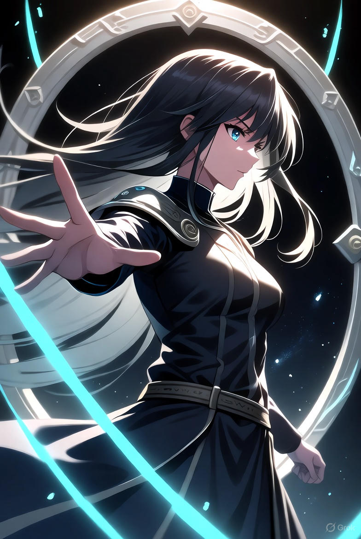
You won!!!!!!!!!!!!
Netadoyou explained that by mixing his DNA with the one of Victoria, the effect on his health and mood would save the world!!
You are the archetypal savior of the universe who doesn't give up!!!!!!!!

