Slide 1
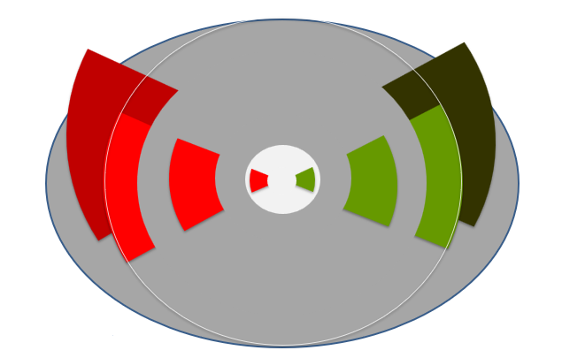

Amnesia – Chapter 2

Slide 2
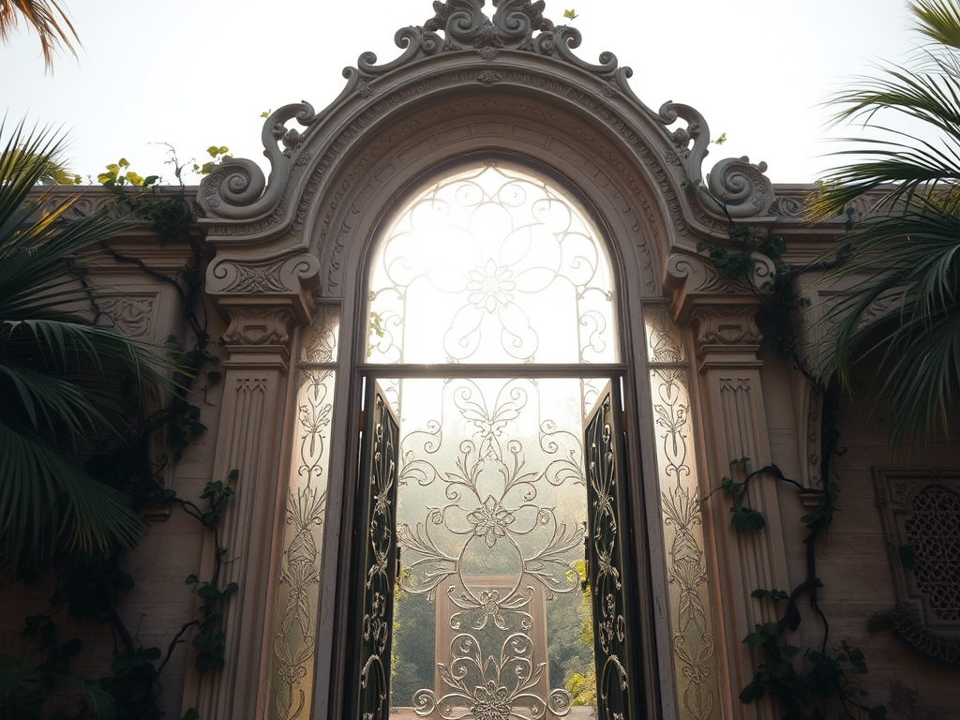
B. You are feeling like there might be something behind you
You walk right through the gate

Slide 3
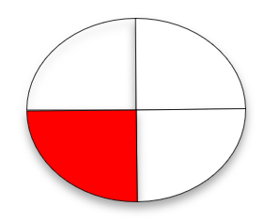
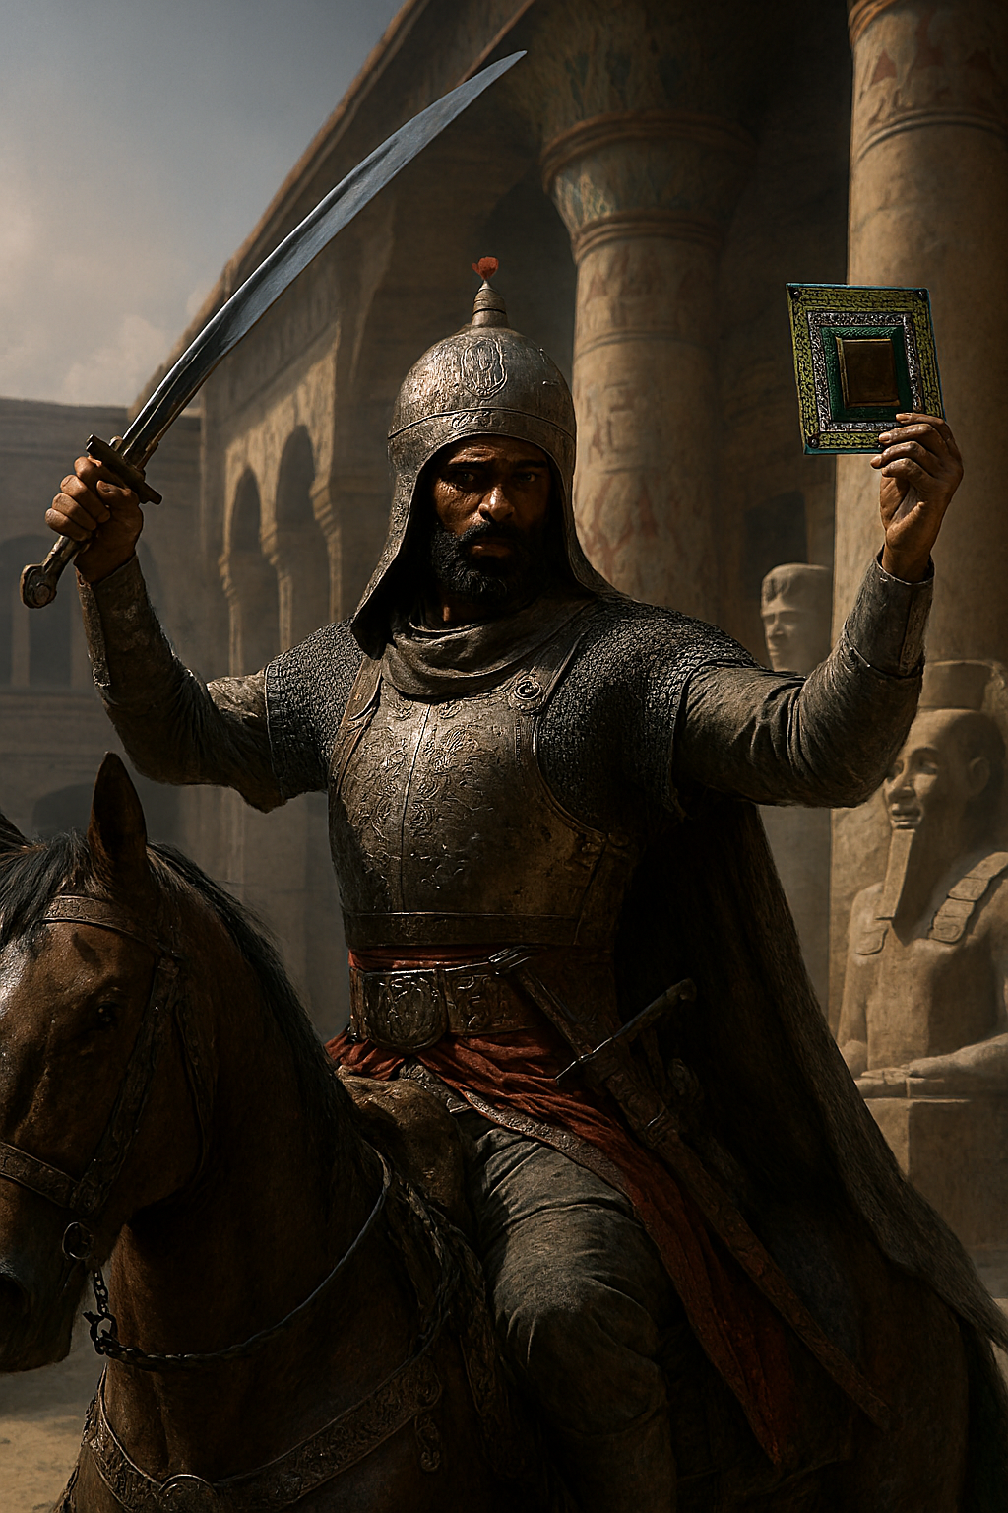
Behind the gate, a warrior shouts out: « I’m carrying the chip that contains the memory of your entire life! Just do everything I say and I will give it to you! »
Do you:
A. Agree to become a slave
B. Fight to take your memory back

Slide 4
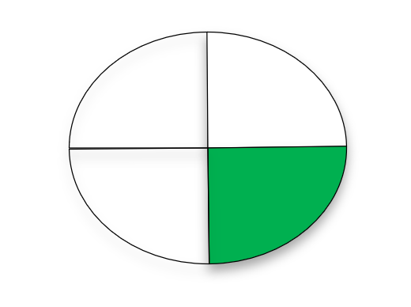
Behind you, there’s a warrior shouts out: « I’m carrying the chip that contains the memory of your entire life! Just do everything I say and I will give it to you! »
Do you:
A. Agree to become a slave
B. Fight to take your memory back

Slide 5
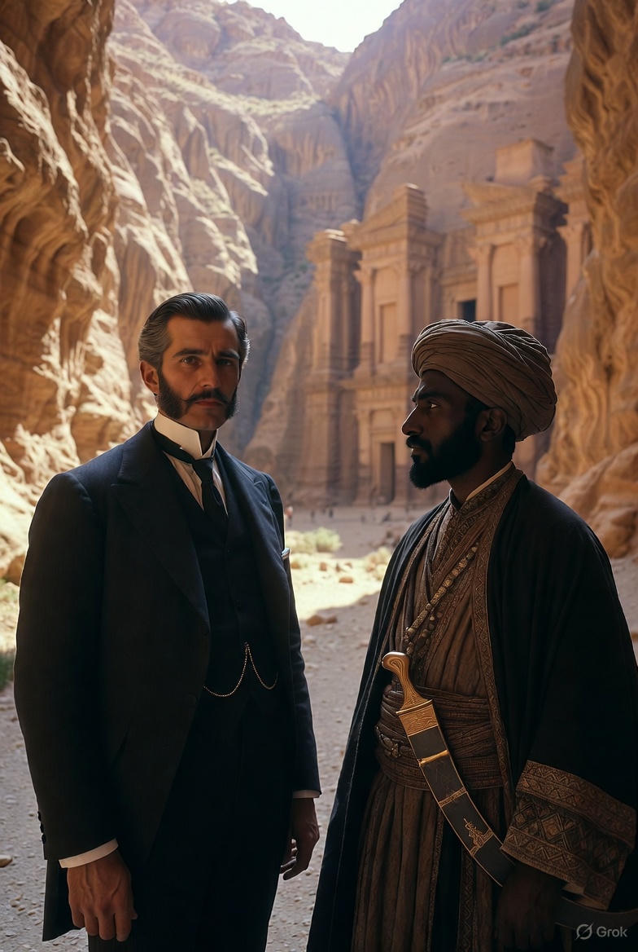
You agreed to be a slave. Now you master is asking you to go inside the « moutain castle » and retrieve the gold hidden behind the snakes.
Do you:
A. agree having in mind to escape behind his back
B. agree to fetch the gold and bring it back to him

Slide 6
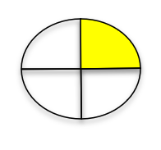
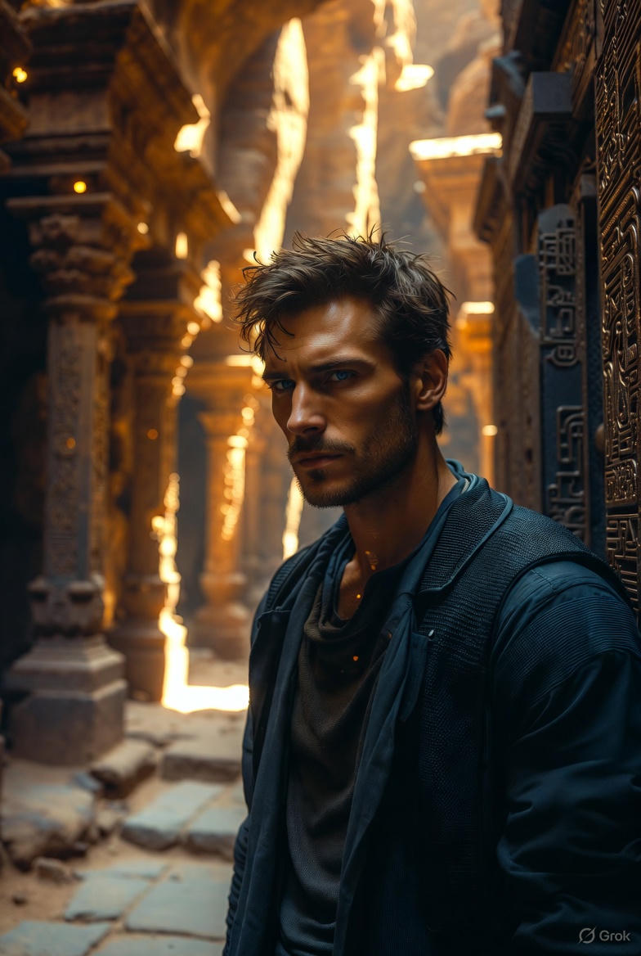
Aiming to escape you are now alone in Petra, do you:
A. Still go looking for the Gold
B. Escape without the Gold because you don’t want to be a slave

Slide 7
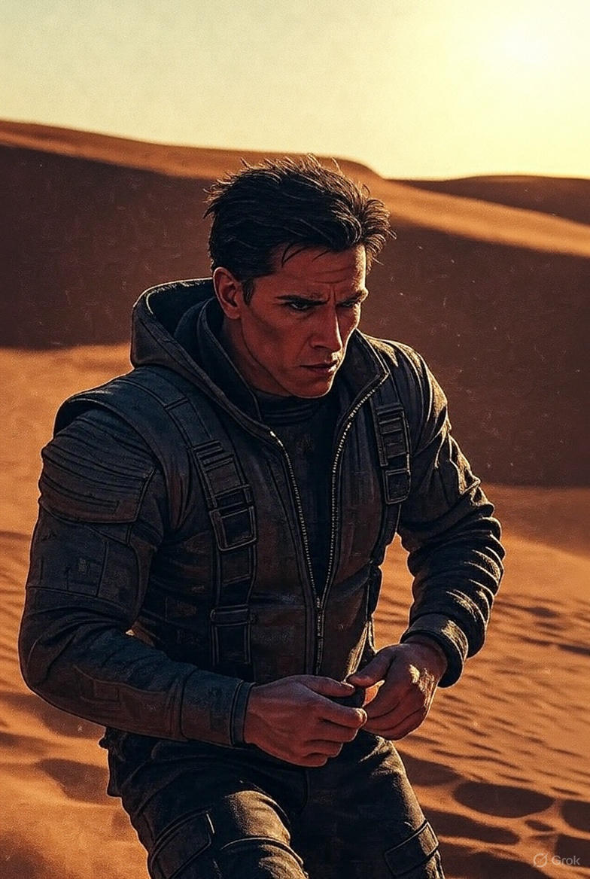
Now you are free. But you are alone in the desert.

Slide 8
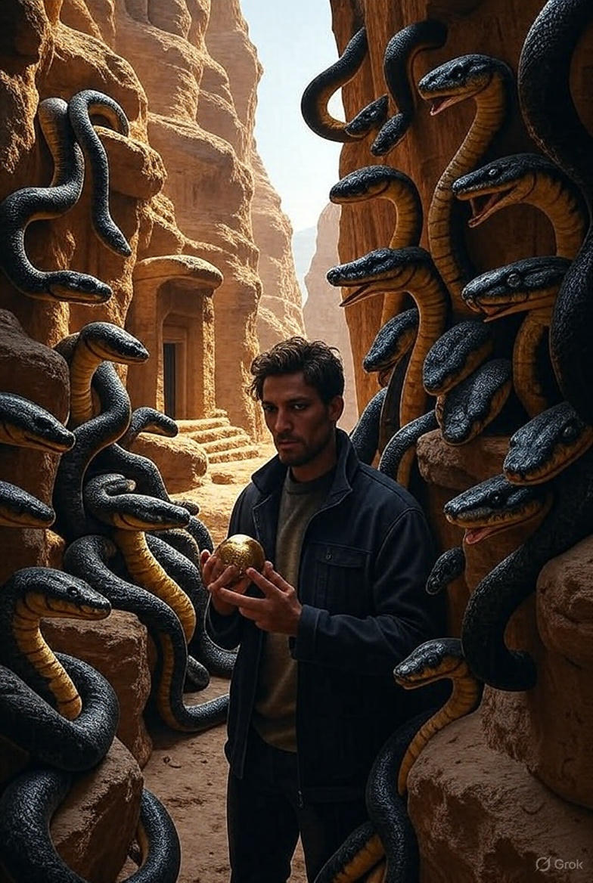
You found the Gold, do you:
A. Bring it back to your master
B. Change your mind and escape because you don’t want to be a slave

Slide 9
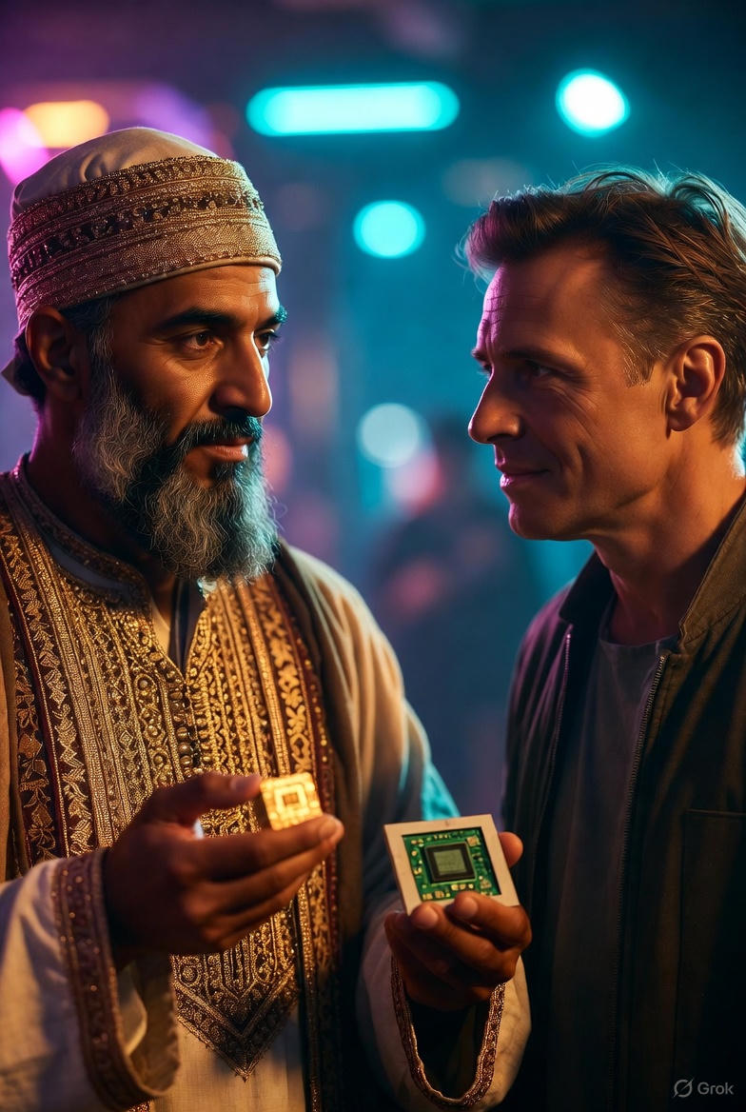
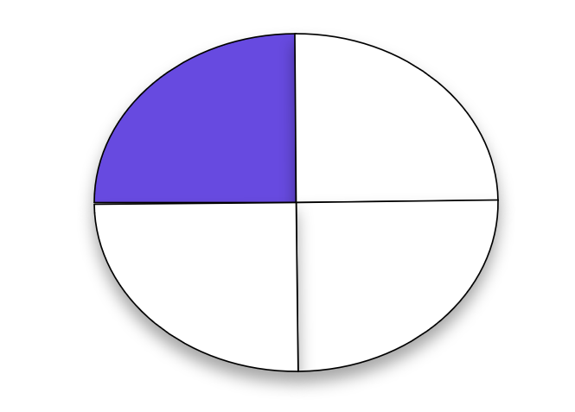
« Thank you for the Gold. In Chapter 3. I will give you more information! »

Slide 10
You do want to know what contains the chip with your memories, so you:
A. Finish your task to fetch the Gold back to your master
B. Change your mind and escape because you don’t want to be a slave

Slide 11
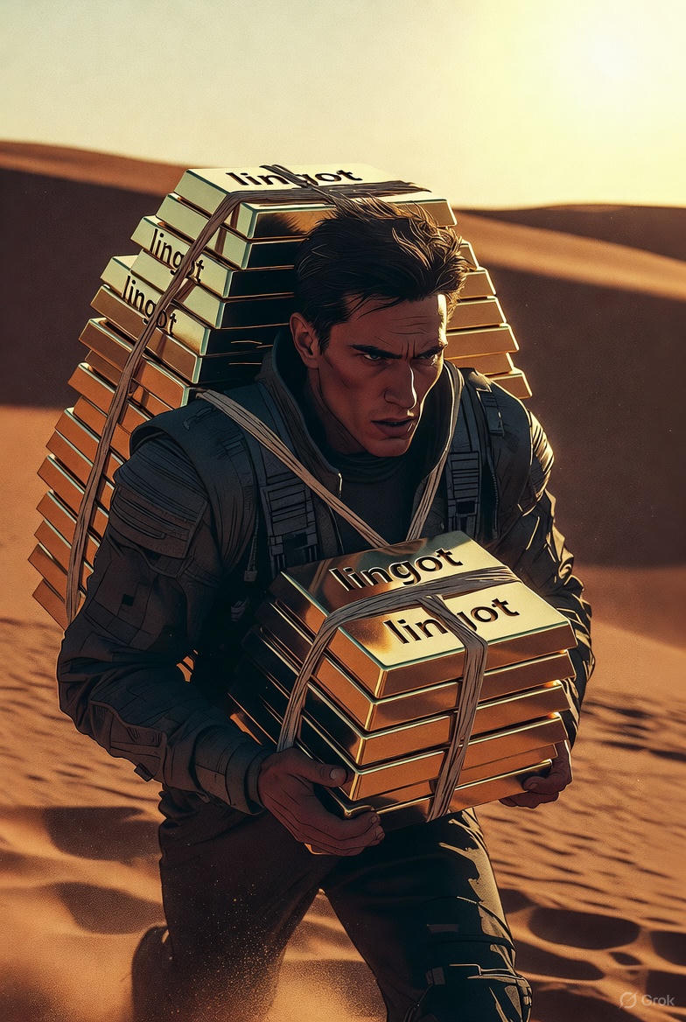
You are running away with the gold! You seem to be free, but the place is desertic. What will happen in Chapter 3?

Slide 12
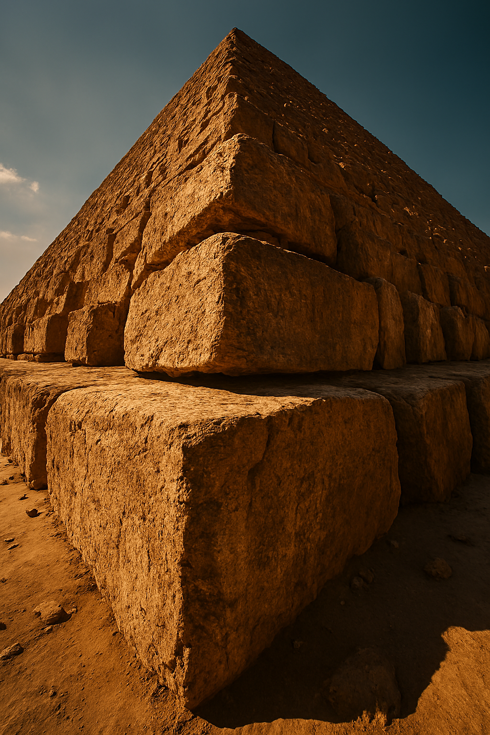
Fighting against that Mamelouk may not have been a good idea.
At least, you are not dead.You seem to be under the GREAT PYRAMID.
What happened?
You decide to: a. go to the top of the pyramid b. look inside the pockets of your clothes

Slide 13
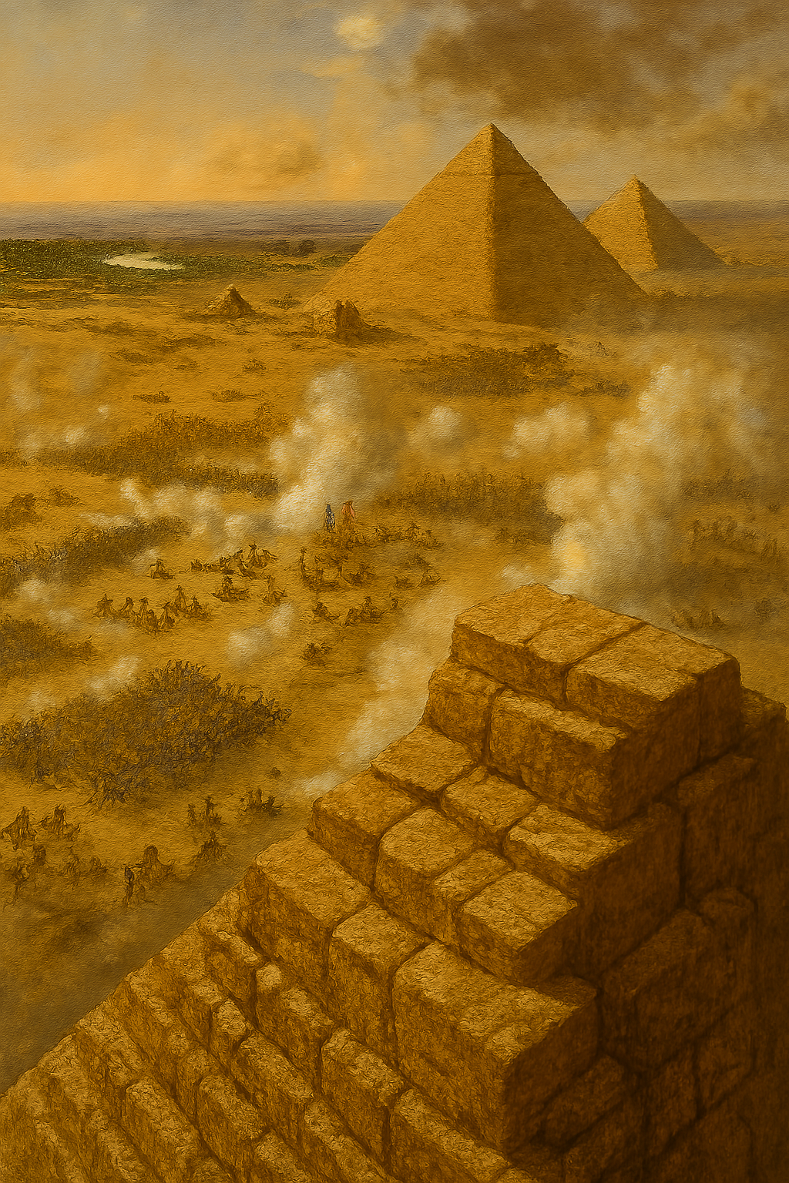
After reaching the top of the pyramid, you realize there is a war going on.
What do you do?
A you look for a place to hide
B. You decide to join the battlefield, you must take part in the action

Slide 14
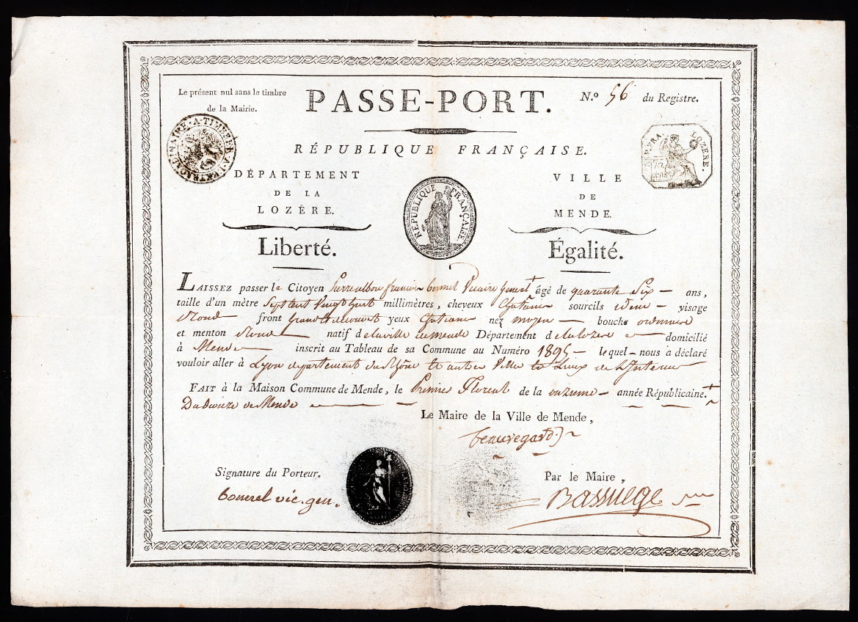
You looked inside your pocket. You appear to be French.
And you are a girl named Marie Chamberlain, born in Paris in 1767.
But what are you doing in Egypt?
See you in Chapter 3!

Slide 15
You maintained your attention. No danger appeared, in the meantime you found an ID in your pocket. According to this passe-port, you are French!
Let’s see what will happen in Chapter 3.

Slide 16
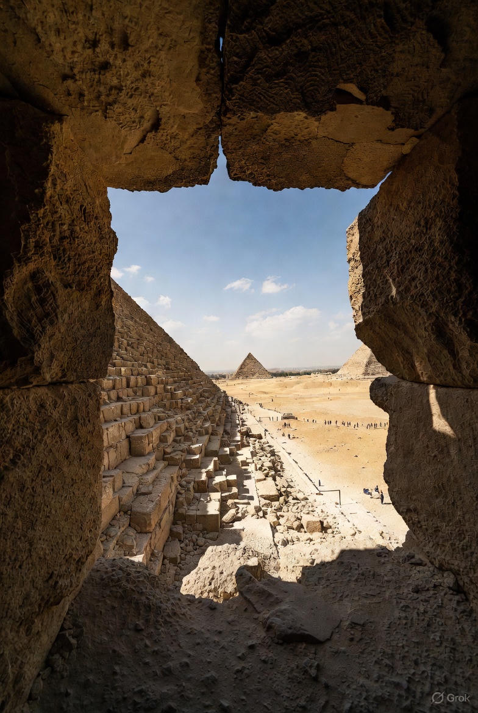
You entered a hole to protect from the burning sun. Now you can see all the action from inside a hole. Do you:
A. Decide to check your pockets
B. Maintain your attention in case of any danger

Slide 17
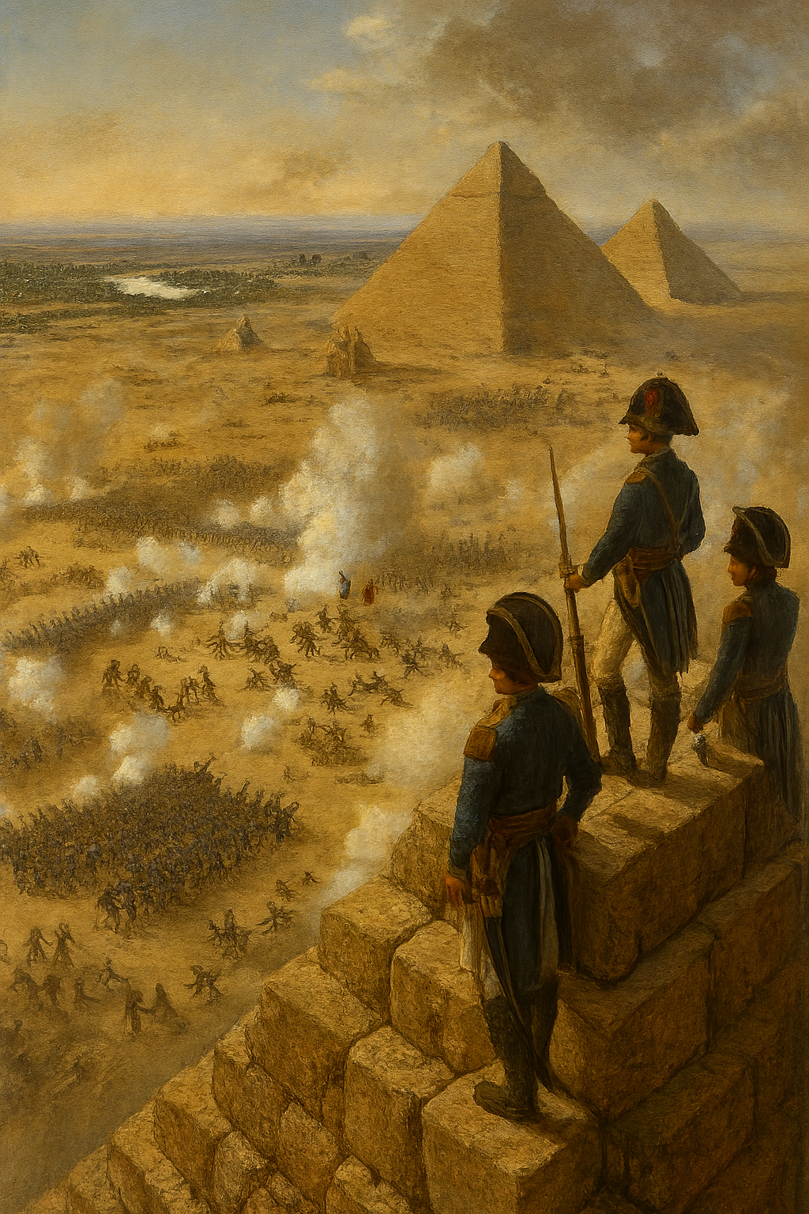
You are now fighting in an army.
What will happen in chapter 3?

