Slide 1

Galactic spies: the War of Minds
A Psyflex « you are the hero » story-game
Maxime Vigier
2025

Slide 2
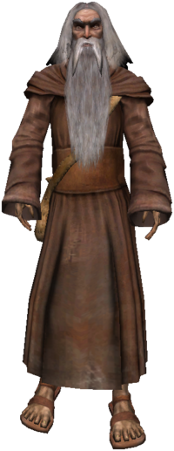

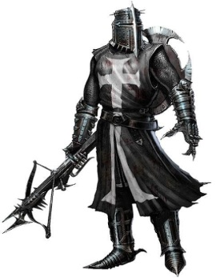
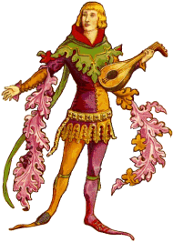
Which hero are you?
PROTECTORS
ADVENTURERS
IDEALISTS
ACHIEVERS

Slide 3

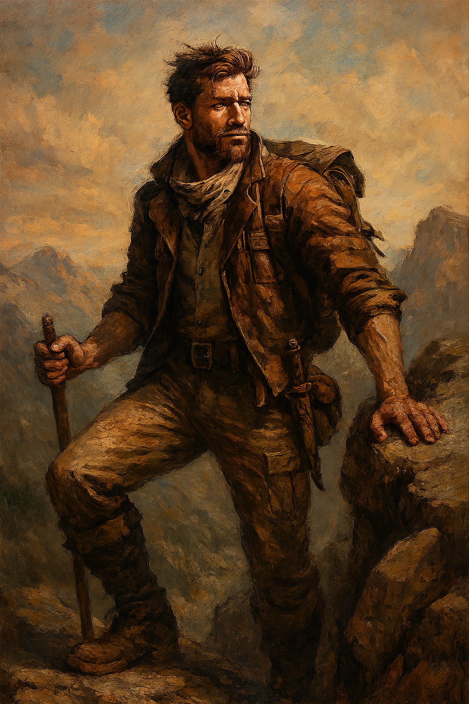
The « adventurer », « explorer », « risk-taker »
ADVENTURERS

Slide 4


The « romantic », « poet », « lover »
IDEALISTS

Slide 5
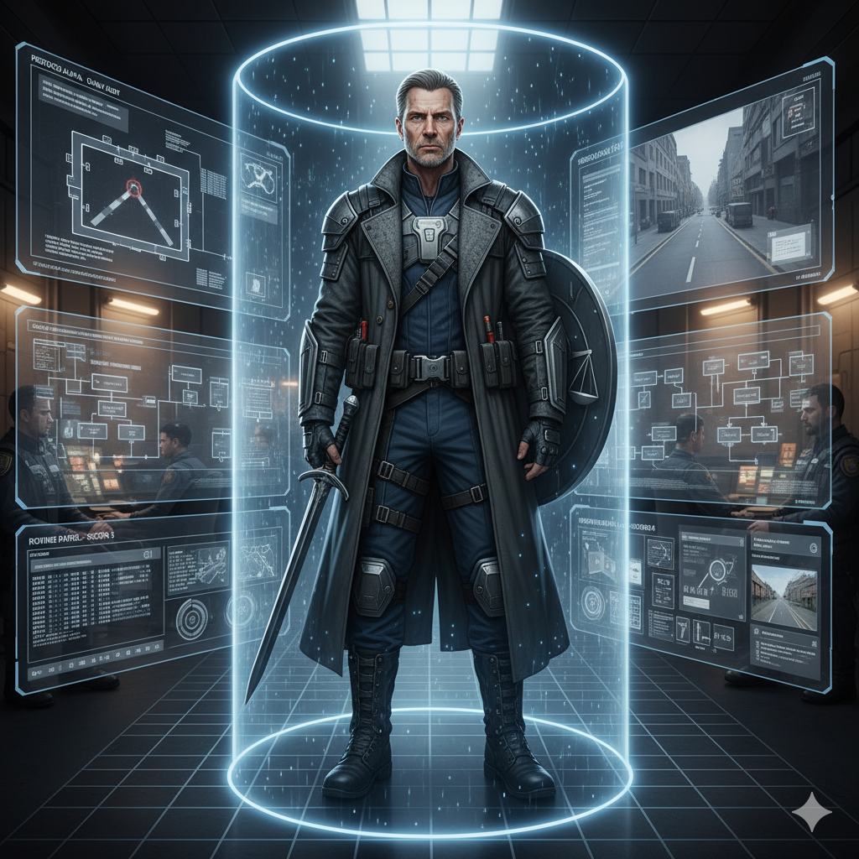

The « warriors », « directors », « planners », « strategists »
ACHIEVERS

Slide 6

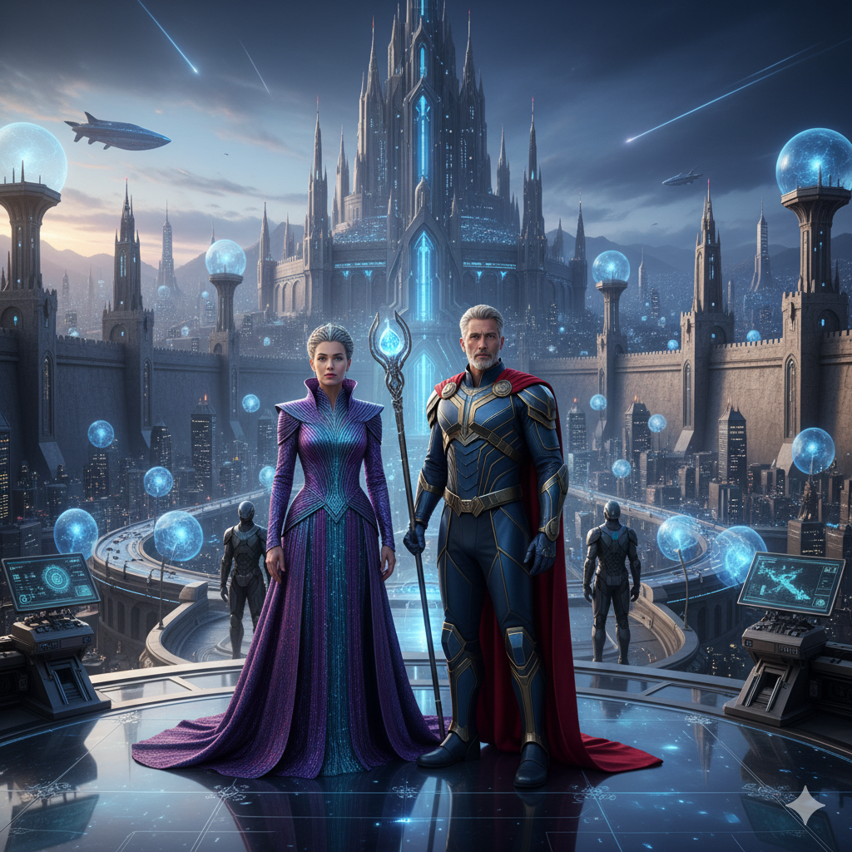
« king/queen », « justice-keeper »
PROTECTORS

Slide 7
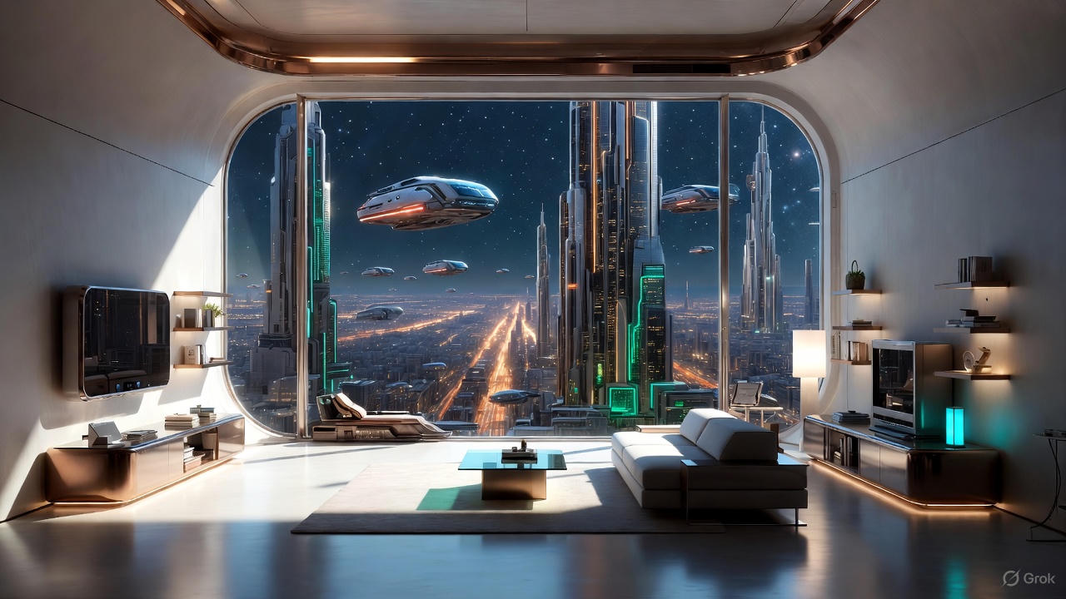
The ADVENTURE GAME that will tell you who you are.

Slide 8
You wake up in the middle of the night. You are alone in an apartment. But you can’t remember where, when, nor who you are.
A. You check the objects inside the room first
B. You decide to take a look outside

Slide 9

After looking at all the rooms inside the apartment, you find a cosmic device
The device informs you that you are stuck in this apartment forever. Do you A. just wait. B. try to break the door to exit that place

Slide 10

The city you are in looks like an endless labyrinth, and far out, there are many skyscrapers.
Do you feel? A. completely lost
B. excited to be in this mess of a world

Slide 11
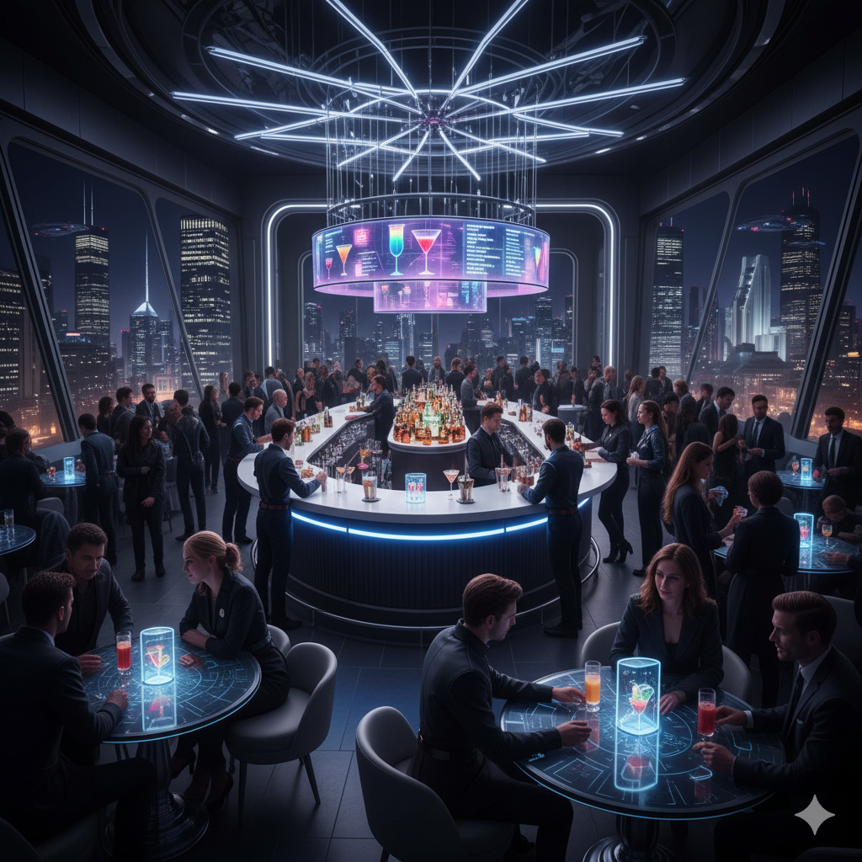
You decided to step into a bar. This place is very crowded.
Do you:
Talk to someone
Just look around

Slide 12
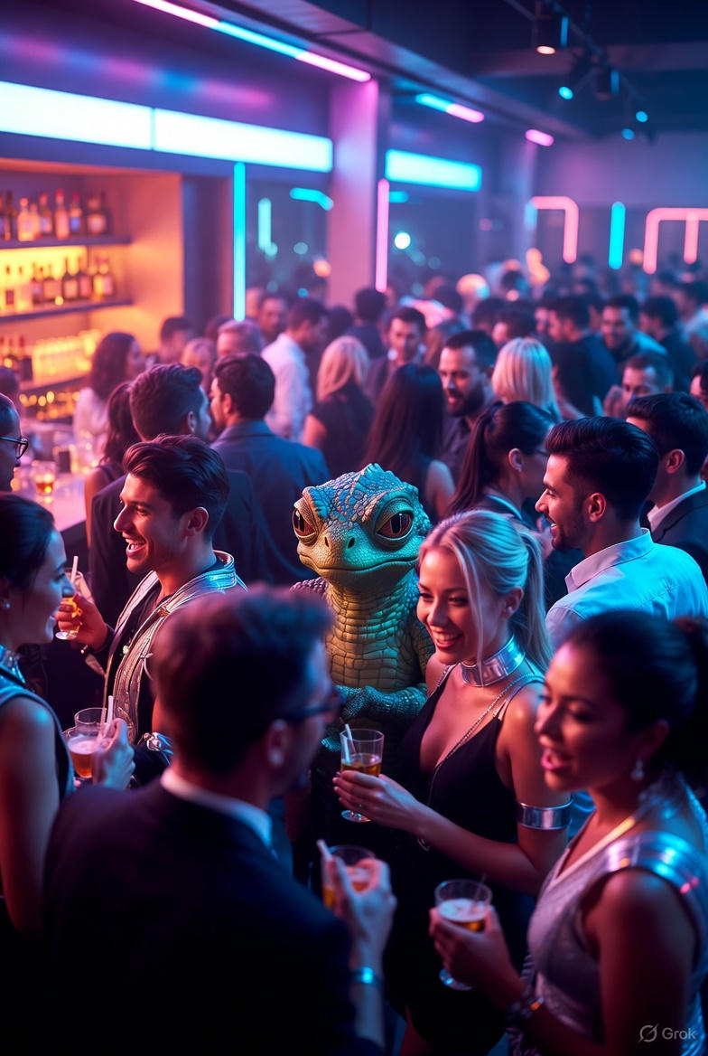
While looking around the bar, you realize there’s a reptilian creature.
You believe that this creature is not supposed to be here.
Do you:
Call the police
Decide to fight that creature by yourself

Slide 13
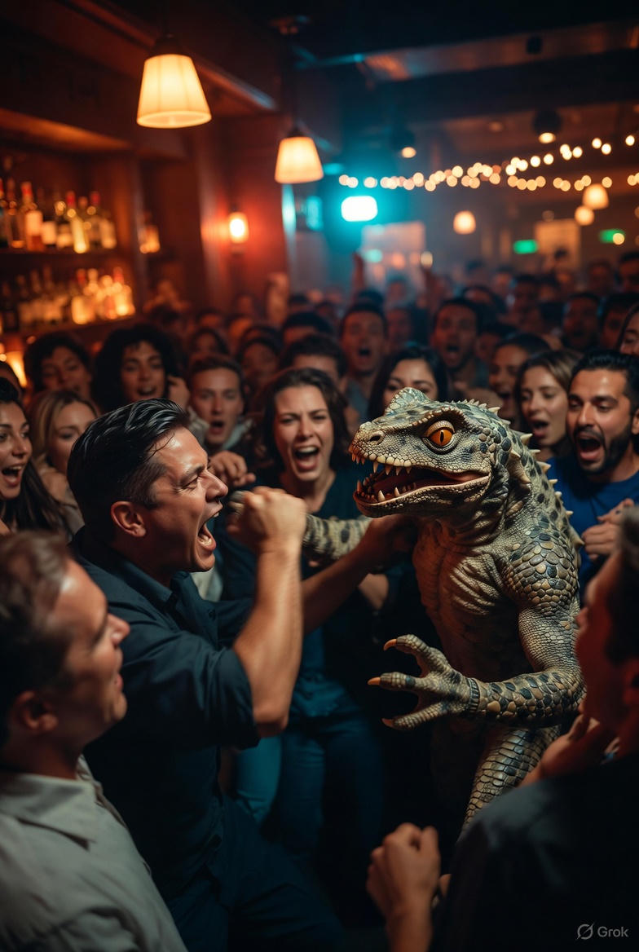
With great perseverance, you fought the reptilian creature.
That creature is now gone.
However, you decide to PREPARE A COUNTER-ATTACK LONG TERM STRATEGIC PLAN TO FIGHT AGAINST THE ALIEN REPTILIAN INVADERS
CELEBRATE

Slide 14
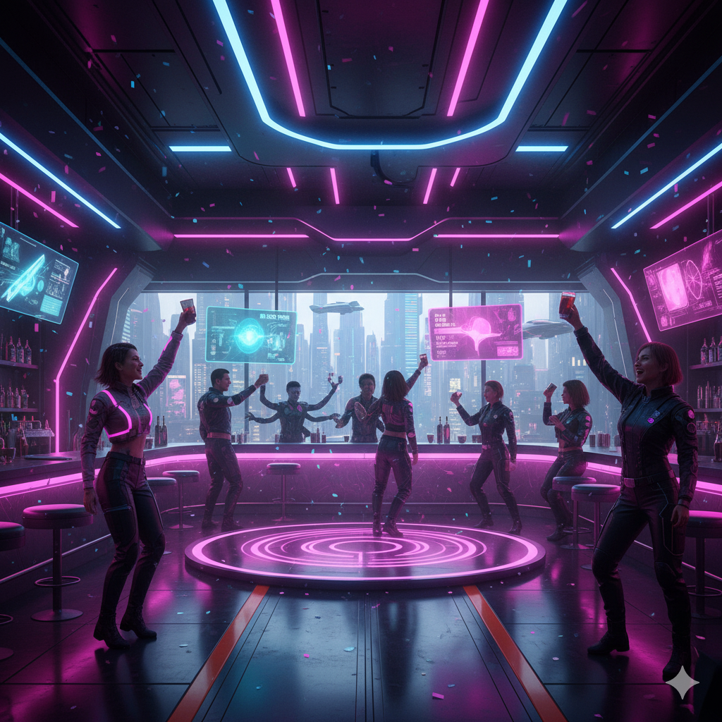
YOU ARE NOW CELEBRATING!!
END OF CHAPTER 1

Slide 15
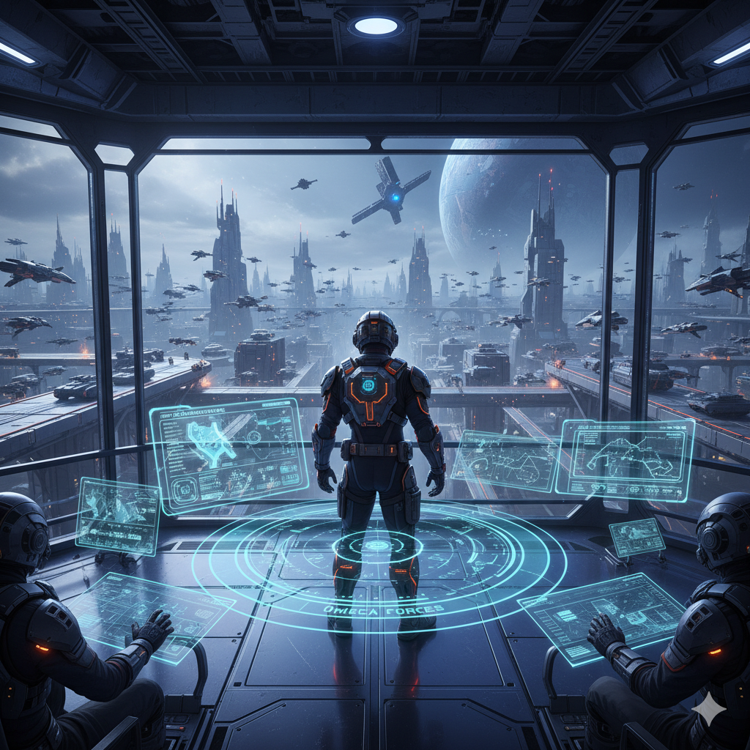
You were given a job in the executive board of management of the army of strategic planning
END OF CHAPTER 1

Slide 16
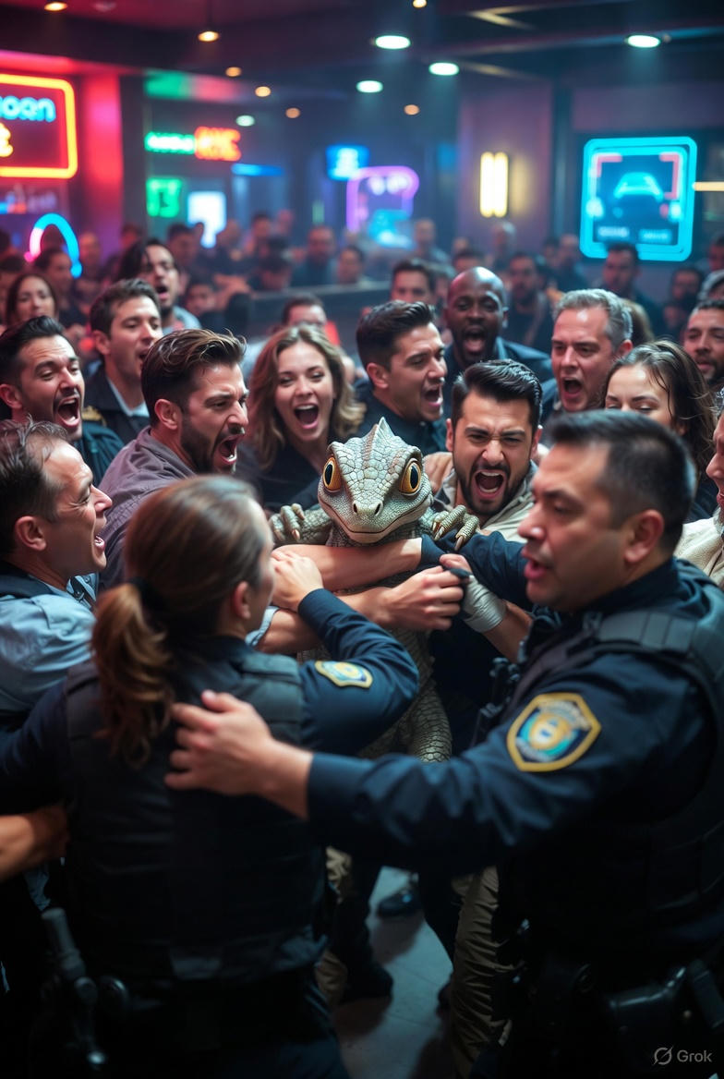
Thanks to your consciousness, the police arrived to grab the creature.
However, you decide to PREPARE A COUNTER-ATTACK LONG TERM STRATEGIC PLAN TO FIGHT AGAINST THE ALIEN REPTILIAN INVADERS
CELEBRATE

Slide 17

You are now talking to your new friend. However, you realize that there’s an suspicious reptilian creature behind her.
Do you:
Call the police
Decide to fight that creature by yourself

Slide 18
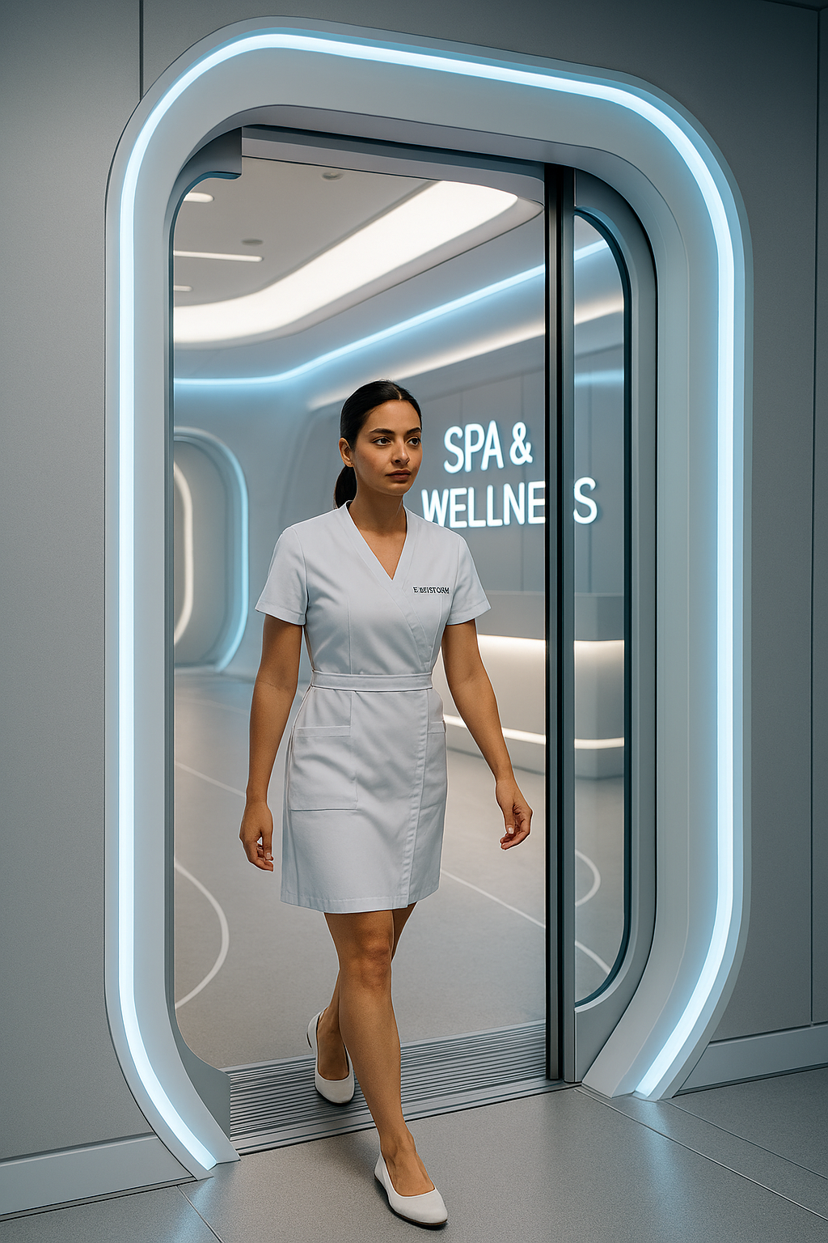
You did a good choice,
A « life manager » walks in. She invites you out.
Do you:
Ask where she is taking you
Just follow her without asking any questions

Slide 19
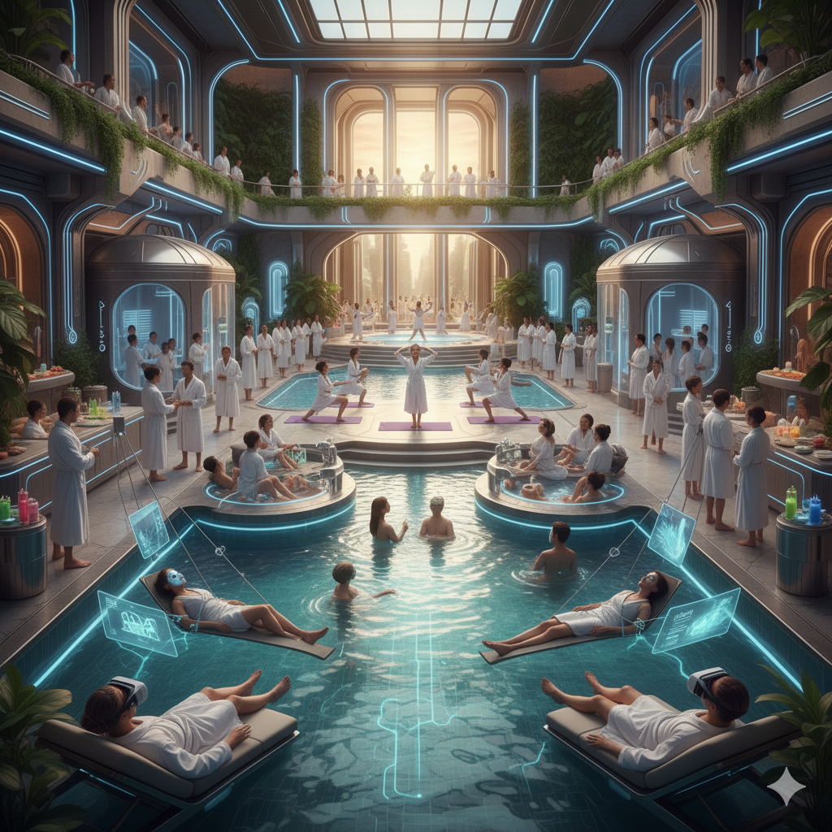
You followed without asking any questions.
Good! This way, you didn’t arouse any suspicion about you!
You are now in a spa surrounded by many people.
Do you:
Talk to someone
Just look around

Slide 20
She tells you that you will relax in a spa.
You are now in a spa surrounded by many people.
Do you:
Talk to someone
Just look around

Slide 21
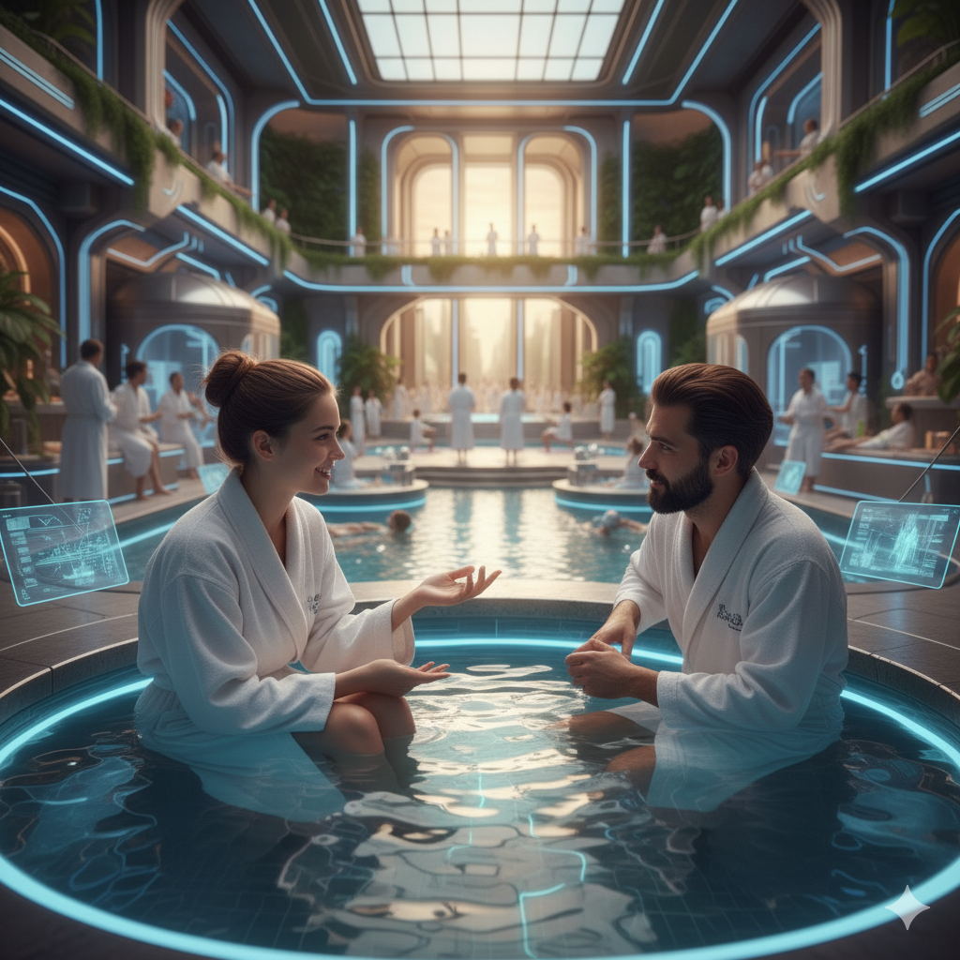
Great, you decided to talk to someone.
You are now talking to your new friend. However, you realize that there’s an suspicious reptilian creature behind her.
Do you:
Call the police
Decide to fight that creature by yourself

Slide 22
You broke out the door.
You are now in a bar. It’s very crowded.
Do you:
Talk to someone
Just look around

